Slide 1
Lecture 4: CAPTURING KNOWLEDGE
Okuboyejo S.R

Slide 2
Stages of KMSLC
Evaluate Existing Infrastructure
Form the KM Team
Knowledge Capture
Iterative Rapid Prototyping
Design KM Blueprint
Verify and validate the KM System
Implement the KM System
Manage Change and Rewards Structure
Post-system evaluation
Notes:
KM system development life cycle is largely composed of 8 stages, which we will briefly discuss in the remaining slides. You should obtain description of their details in both the lecture notes and the prescribed text.

Slide 3
What Is Knowledge Capture ?
A process by which the expert’s thoughts and experiences are captured
A knowledge developer collaborates with an expert to convert expertise into a coded program
In simple terms, we want to “know” how experts know what they know

Slide 4
Three important steps
Use an appropriate tool or technique to elicit information from the expert
Interpret the information and infer the expert’s knowledge and reasoning process
Use the interpretation to build rules that represent expert’s solutions

Slide 5
Improving the Knowledge Capture Process
Focus on how experts approach a problem
Look beyond the facts or the heuristics
Re-evaluate how well the problem domain is understood
How accurate the problem is modeled

Slide 6
Using a Single Expert
Advantages:
Ideal when building a simple KM system
A problem in a restricted domain
Easier to coordinate meetings
Conflicts are easier to resolve
Shares more confidentiality than does multiple experts

Slide 7
Using a Single Expert (cont’d)
Disadvantages:
Sometimes expert’s knowledge is not easy to capture
Single expert provides only a single line of reasoning
Expert knowledge is sometimes dispersed
Single expert more likely to change scheduled meetings than experts in a team

Slide 8
Using Multiple Experts
Advantages:
Complex problem domains benefit from expertise of more than one expert
Working with multiple experts stimulates interaction
Allow alternative ways of representing knowledge
Formal meetings often a better environment for generating thoughtful contributions

Slide 9
Using Multiple Experts (cont’d)
Disadvantages:
Scheduling difficulties
Disagreements often occur among experts
Confidentiality issues
Requires more than one knowledge developer
Overlapping mental processes can lead to “process loss”

Slide 10
Developing a Relationship With Experts
Create the right impression
Understanding the expert’s style
Prepare well for the session
Decide where to hold the session

Slide 11
Approaching Multiple Experts
Individual
An extension of single expert approach
Primary and secondary
Start with the senior expert first, on down to others in the hierarchy
Small groups
Each expert tested against expertise of others in the group

Slide 12
Analogies and Uncertainties in Information
Experts use analogies to explain events
Expert’s knowledge is the ability to take uncertain information and use a plausible line of reasoning to clarify the fuzzy details

Slide 13
Analogies and Uncertainties in Information (cont’d)
Reliable knowledge capture requires understanding and interpreting expert’s verbal description of information, heuristics, etc.
For example, words like possible, likely, and definite show relationships between words and belief

Slide 14
The Interview As a Tool
Commonly used in the early stages of tacit knowledge capture
The voluntary nature of the interview is important
Interviewing as a tool requires training and preparation
Convenient tool for evaluating the validity of information acquired

Slide 15
Types of Interviews
Structured: Questions and responses are definitive. Used when specific information is sought
Semi-structured: Predefined questions are asked but allow expert some freedom in expressing the answers
Unstructured: Neither the questions nor their responses specified in advance. Used when exploring an issue

Slide 16
Variations of Structured Questions
Multiple-choice questions offer specific choices, faster tabulation, and less bias by the way answers are ordered
Dichotomous (yes/no) questions are a special type of multiple-choice question
Ranking scale questions ask expert to arrange items in a list in order of their important or preference

Slide 17
Guide to a Successful Interview
Set the stage and establish rapport
Properly phrase the questions
Question construction is important
Listen closely and avoid arguments
Evaluate session outcomes

Slide 18
Things to Avoid
Taping a session without advance permission from the expert
Converting the interview into an interrogation
Interrupting the expert
Asking questions that put the domain expert on the defensive

Slide 19
Things to Avoid (Cont’d)
Losing control of the session
Pretending to understand an explanation when you actually don’t
Promising something that cannot be delivered
Bring items not on the agenda

Slide 20
Sources of Error that Reduce Information Reliability
Expert’s perceptual slant
Expert’s failure to remember just what happened
Expert’s fear of the unknown
Communication problems

Slide 21
Errors Made by the Knowledge Developer
Age effect
Race effect
Gender effect

Slide 22
Problems Encountered During the Interview
Response bias
Inconsistency
Communication difficulties
Hostile attitude
Standardized questions
Lengthy questions
Long interview

Slide 23
OTHER KNOWLEDGE CAPTURE TECHNIQUES

Slide 24
Other Techniques
On-site Observation (Action Protocol)
Brainstorming (Conventional & Electronic)
Consensus Decision Making
Nominal Group Technique
Delphi Method
Repertory Grid
Concept Mapping
Blackboarding
Notes:
Today, we will learn about the KMSLC, that is the actual stages involved in the development of a working KMS:
First, I will highlight several major challenges one might face when constructing KM systems. This will set the stage for the remaining discussion on KMSLC.
For some of you, you might be familiar with the system development life cycle for conventional systems. But how about KMSLC? What are the main similarities and differences between the conventional life cycle and the KMSLC that we will be learning today?
Next, we will attempt to understand some characteristics of a user (or person using a system) as compared to an expert who are knowledgeable in an area where we are attempting to apply KM.
Altogether, we can identify 8 distinct stages in a KMSLC (at least as outlined in our textbook by Awad and Ghaziri). For the most part, the stages are sequential. But, there are certain stages that are iterative because of the methodology applied in developing KMS.

Slide 25
On-Site Observation
Process of observing, interpreting, and recording expert’s problem-solving behaviour as it takes place
Places the knowledge developer closer to the actual steps and procedures used by the experts

Slide 26
On-Site Observation (cont)
Problems:
Some experts do not like to be observed
Reactions from peers during observation can be distracting
Accuracy or completeness of captured knowledge weakened by time gap between observation and recording

Slide 27
Brainstorming
An unstructured, consensus-based approach to generating ideas about a problem
Suitable for multiple experts
All possible solutions considered equally
Goal is to foster the frequency of responses during the session
Conclude by idea evaluation

Slide 28
Role of Knowledge Developer in Brainstorming Session
Introduce and coordinate the brainstorming session
Give experts a problem to consider
Prompt experts to generate ideas
Watch for signs of convergence
Call for a vote to reach agreement

Slide 29
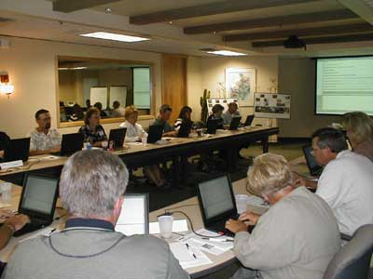
Electronic Brainstorming
Computer-aided approach to brainstorming
Promote instant exchange of ideas between experts
Require a pre-session plan to identify objectives and structures the agenda
Anonymity reduces effects of shyness, etc.
Shorter meeting with concise recommendations

Slide 30
Protocol Analysis
Think-aloud approach
Expert verbalizes while going through a problem solution
Protocols are recorded and analyzed
Knowledge developer does not interfere in the solving process
Structuring of recorded information occurs when knowledge developer analyzes the protocols.

Slide 31
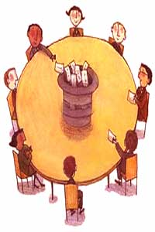
Consensus Decision Making
Consensus is a process for group decision-making
Input of all participants are gathered and synthesized to arrive at a final decision, that is acceptable to all
Through consensus, not only achieve better solutions, but also promote community and trust
As a tool, it follows brainstorming

Slide 32
Consensus Procedure
A proposal for resolution is put forward
Amend and modify proposal through discussion
Those participants who disagree with the proposal have the responsibility to put forward alternative proposals
The one who put forward the proposal, with help of facilitator, can choose to withdraw proposal if seems to be dead end.

Slide 33
Consensus Procedure
When a proposal seems to be well understood and no new changes asked for, the facilitator confirm any objections
If no objections, the facilitator can call for consensus
If there are still no objections, then after a moment of silence, you have the decision
If consensus appears to have reached, the facilitator repeats the decision so everyone is clear

Slide 34
Nominal Group Technique (NGT)
An idea writing technique
A structured variation of small group discussion method
Prevents the domination by a single expert
Encourages the more passive experts to participate
Results in a set of prioritized solutions or recommendations

Slide 35
NGT (Advantages)
Effective in minimizing differences in status among multiple experts
Each expert has an equal chance to express ideas in parallel with other experts in the group(s)
With the discussion proceeds in controlled order, it can be more efficient and productive than brainstorming

Slide 36
NGT (Drawbacks)
Technique can be time consuming
Could promote impatience among experts who must listen to discussions with other experts
With multiple experts sharing expertise, a cause of difficulty in adopting the best solution

Slide 37
Delphi Method
A survey of experts
A series of questionnaires developed to pool experts’ responses in solving a difficult problem
Each expert’s contributions shared with rest of experts by using results of one questionnaire to construct the next questionnaire

Slide 38
Delphi Method (Pros and Cons)
Pros
Anonymous response
Controlled feedback
Statistical group response
Cons
Poorly designed questionnaire can be ineffective in capturing the complexity of the problem domain
Experts may lack complete knowledge to base their answers

Slide 39
The Repertory Grid
An expert conceptualizes the problem using his or her own model
Grid used to facilitate the capture and evaluation of the expert’s model
A representation of the experts’ reasoning about a particular problem
A grid can be a scale or a bipolar construct on which elements are placed within gradations

Slide 40
Job Interview Rating Repertory Grid (Example)
Construct | T1 | T2 | T3 | T4 | T5 | T6
A. Inexperience | 3 | 3 | 1 | 1 | 1 | 1
B. Academically Ill-qualified | 2 | 1 | 2 | 1 | 1 | 3
C. Poor Appearance | 3 | 2 | 1 | 2 | 1 | 3
D. Not punctual | 2 | 3 | 2 | 3 | 1 | 1
E. Introverted | 2 | 3 | 2 | 2 | 1 | 1
Scale: 1 to 3
Dixie
John
Barry
Curt
Lester
Joanne

Slide 41
The Repertory Grid (Pros and Cons)
Benefit: may prompt the expert to think more concretely about the problem and how to solve it.
Drawback: difficult to manage when large grids are accompanied by complex details
Because of complexity and manageability, the tool is normally used in the early stages of knowledge capture

Slide 42
Concept Mapping
A network of concepts, consisting of nodes and links
A node represents a concept and a link represents the relationship between concepts.
An effective approach for:
design a complex structure (Web sites)
generate or communicate ideas (e.g., during brainstorming)
diagnose misunderstanding

Slide 43
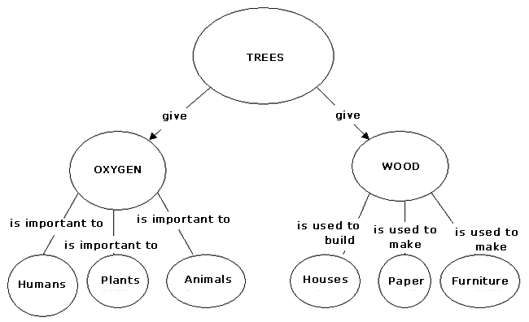
Concept Map - A Simple Example

Slide 44
Steps in Concept Mapping
1 Preparation of Project
Participants, focus, schedule
2
Idea Generation
(focus for brainstorming)
6
Utilization
STEPS IN
CONCEPT
MAPPING
3
Idea Structuring
(sorting/rating statements)
5
Interpretation
(cluster analysis)
4
Representation

Slide 45
Blackboarding (Groupware)
Participants are assumed experts with unique experience
Each expert has equal chance to contribute to the solution via the blackboard
Process continues until the problem has been solved

Slide 46
Blackboarding (Characteristics)
Participants share a common protocol for interaction
Organized participation
Iterative approach to problem solving
Flexible representation of information
Efficient storage and location of information

Slide 47
Deciding where to hold the sessions
Beneficial in recording the expert’s knowledge in the environment where he or she works
An important guideline is to make sure the meeting place is quiet and free from interruptions

